Slide 1
Making a React App with Firebase Integration
By Josh and Jerry

Slide 2
Introduction to the React App
React-based web app
Made using the React JS
Order and user account management
Allows users to manage orders and their account information
Dark-themed UI
Features a simple, clean, dark-themed user interface
Firebase integration
Uses Firebase API for user authentication and data storage
Key pages
Home, Order Materials, Cart, Admin Dashboard, Login/Signup

Slide 3
The Homepage
The homepage of our app shows the products and special offers, designed using React components and styled with a CSS file. The navbar component provides navigation links to other pages like the Order Materials page and the Cart page, allowing users to easily navigate the application.

Slide 4
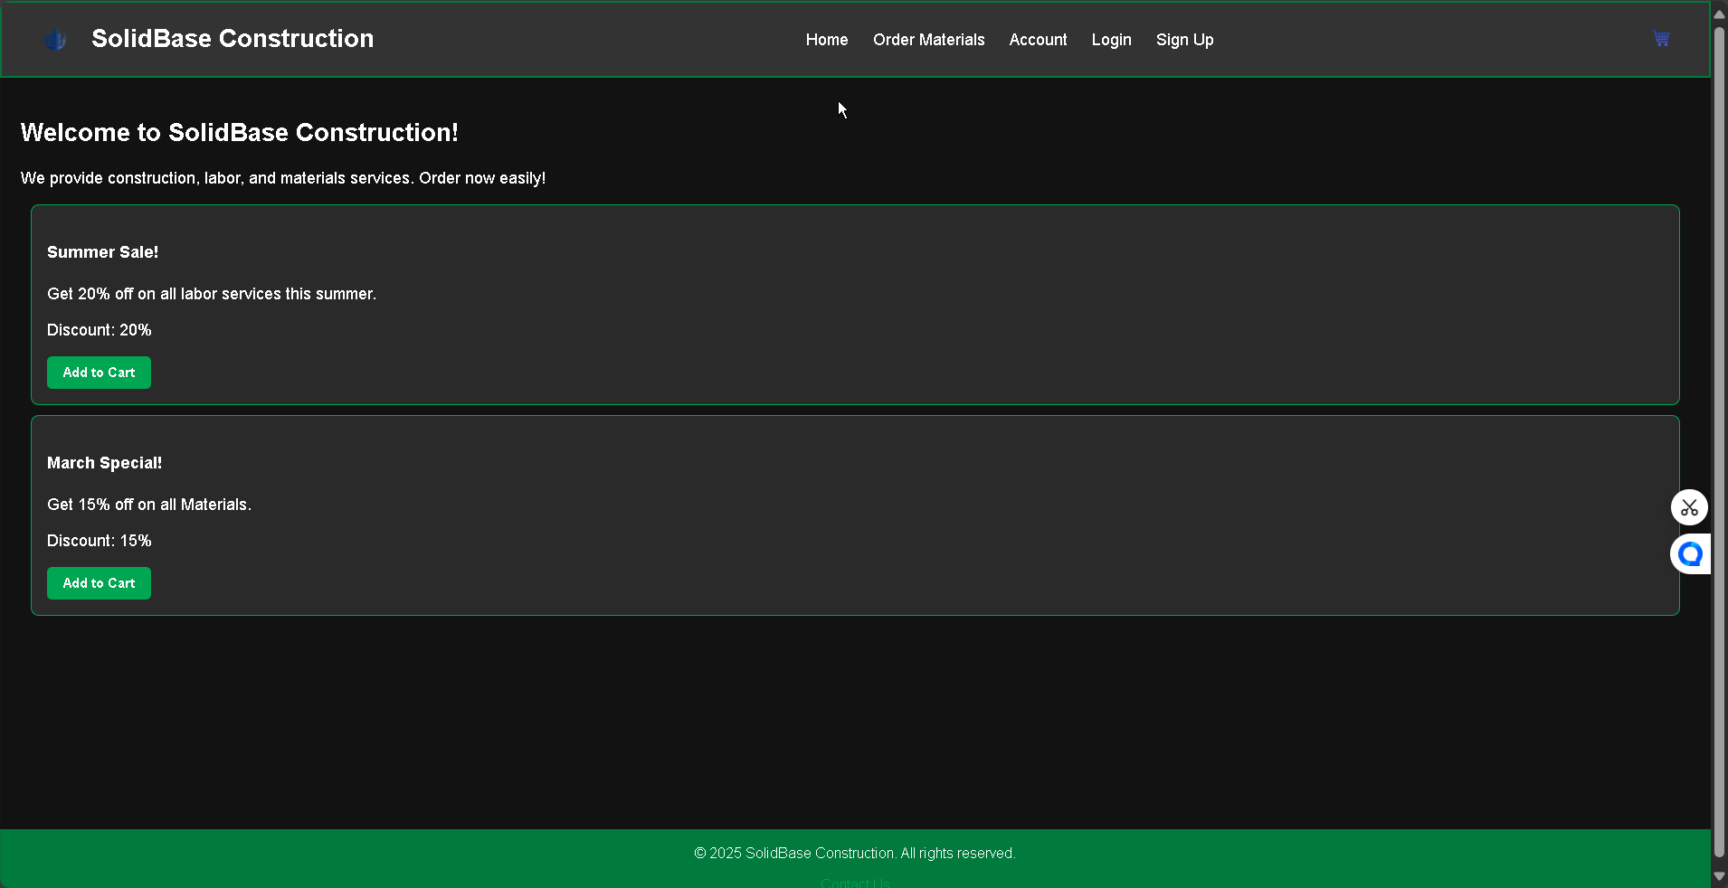
-
-

Slide 5
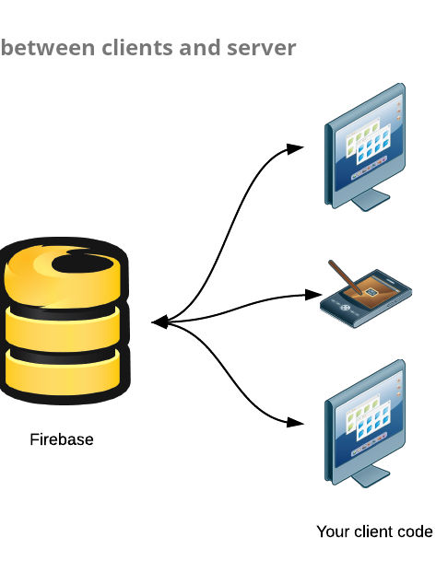
Setting Up Firebase Integration
The React app integrates Firebase for authentication as well as data storage. The firebase.js file initializes Firebase with the configuration copied from my Firebase account page, which includes the API key, project ID, and app ID. This file then exports the Firestore (db) and Authentication (auth) services, making them available for use in the App.

Slide 6
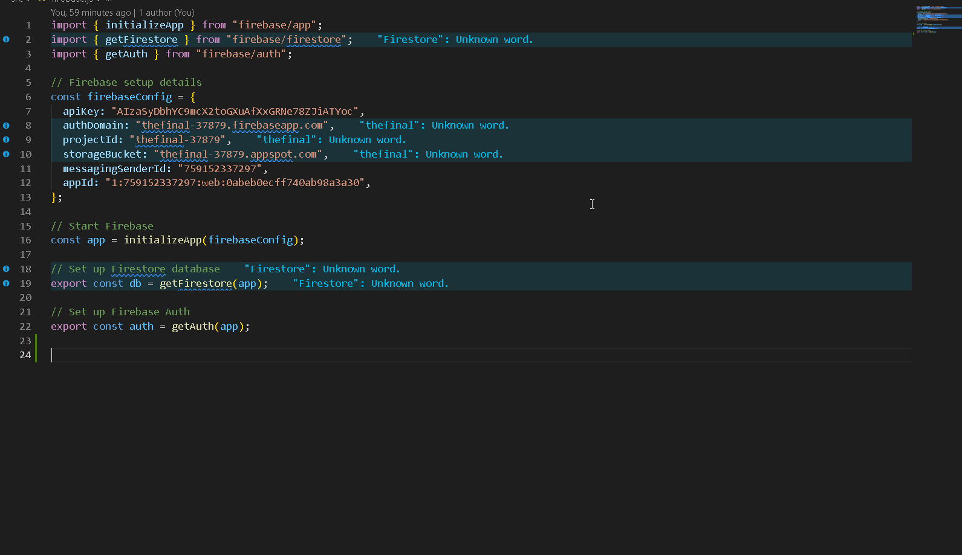

Slide 7
Firebase Authentication with UserContext
The user's email, UID, and admin status (if the email is admin@gmail.com) are stored in the user state, which is then provided to all components through the userContext.js file. This allows for conditional rendering, such as redirecting not logged-in users from the /order page to the /login page.

Slide 8
Firestore for Data Management
The app uses Firestore, a cloud database provided by Firebase, to store and manage the services data for the application. The UserContext.js file retrieves the services data from the 'services' collection in Firestore using the getDocs() method, which retrieves all the documents and maps them to an array with their own IDs. This service's data is then stored in the application's state and made accessible to all components through the context.

Slide 9
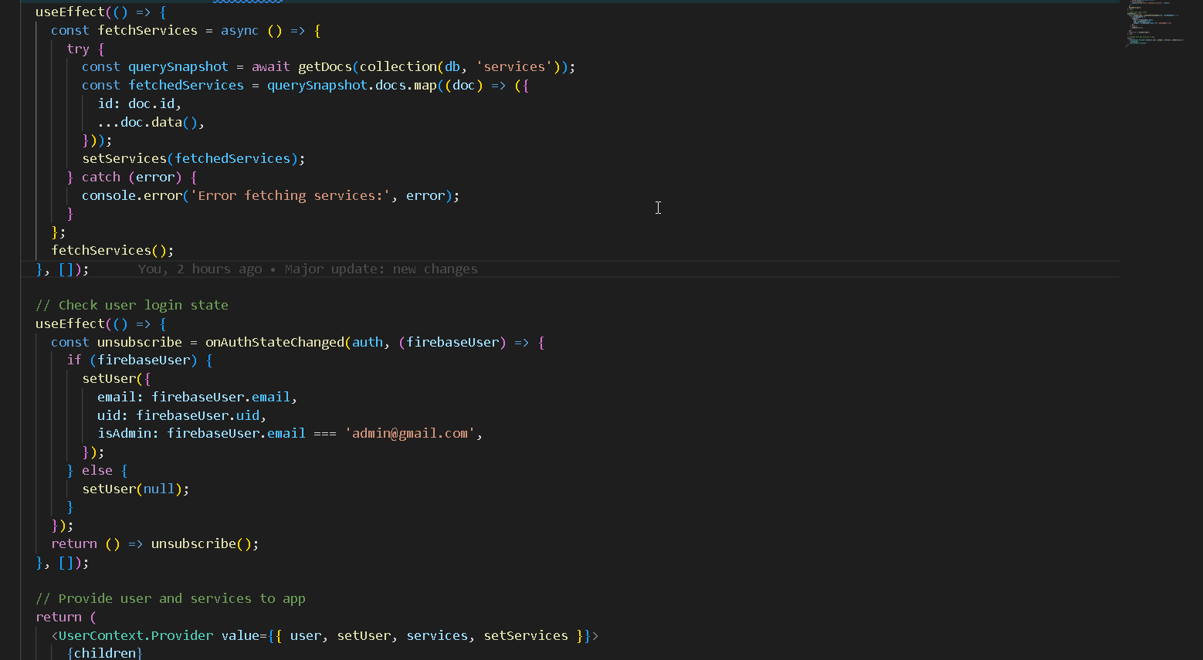

Slide 10
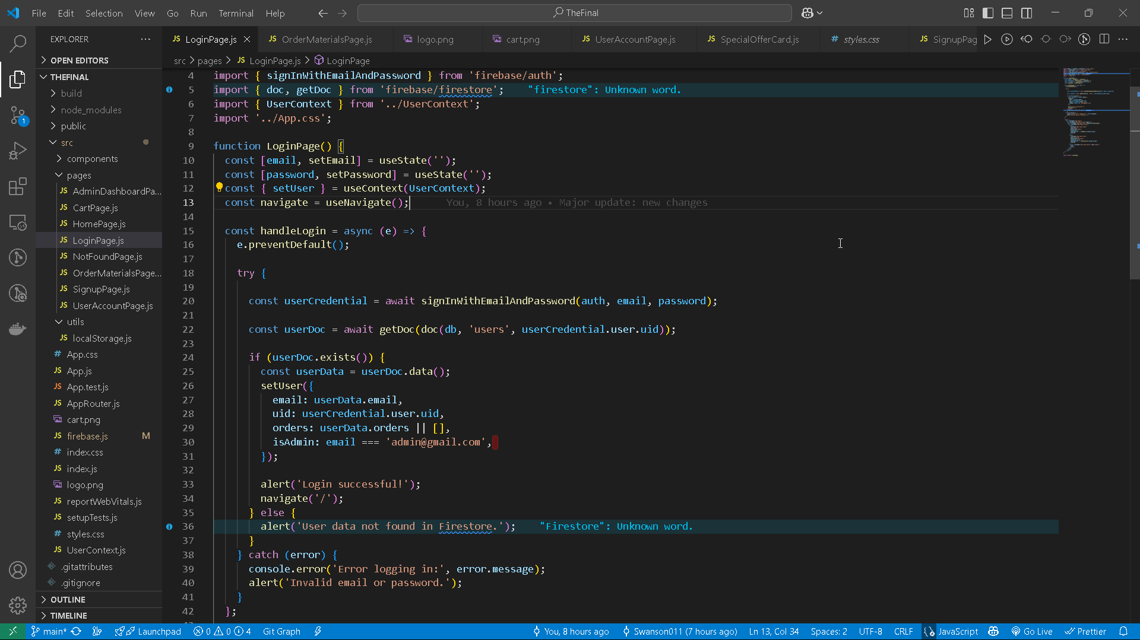

Slide 11




Key Features and Pages
HomePage
OrderMaterialsPage
CartPage
AdminDashboardPage
Displays products and special offers
Allows authenticated users to place orders
Manages cart items with remove functionality
Admin-only page for managing services

Slide 12



Conclusion and Future Improvements
Successfully built a React app with Firebase for auth and data
Implement more admin features
Imrpove UI
Develop advanced administrative features to provide better control and management capabilities for the application.
Improve the user interface by Make incorporating smooth animations and transitions, as well as making the website usable on Mobile devices.
The presentation shows the successful use of a React web application with Firebase for authentication and data management.
React App

